Slide 1

Roomies
Group Members
Ajinkya Bhosale(220343120005)
Kishor Janjal(220343120040)
Satnam Singh Veerak(220343120113)
Snehal Deshmukh(220343120104)
Project Guide – Mrs. Harshit Maheshwari

Slide 2
Contents
Introduction
Choice Of Topic
Proposed System
Methodology
Proposed System Model
Proposed Approach
Screenshot
System Requirement
Application
Advantages & Limitation
Conclusion
Future Scope
References

Slide 3


Introduction
Roomies Is a Web Application that helps to find a roommate with the same interests in an unfamiliar city.
Finding a suitable Hostel/Flat is a challenge most people face at some point in their lives while moving to a new place.
In most, cases it is not enough to just find a room/flat but also to find one under the budget that suits our needs is not an easy task.
So, this project tries to enhance how we can help the user with easy navigation with an easy User Interface (UI) / User Experience (UX).

Slide 4
Choice Of Topic
Through this Project Customers will get a good deal
Hostel/Flats Owner also benefited from this as need of middleman is vanished
Different Pages For Hostel / Flat Listing

Slide 5
Proposed System
Aim :
Provide Best Deal to Customer as well as Owner
Proposed System :
Eliminate Intermediated
Communication can take place using Chat or Email
Digitalize Hostel / Flat Searching Process

Slide 6
Methodology
The Objective is to create a web app that can perform the following
Authenticate and Authorization of users
Giving Owner ability to Add Hostels / Flats
Giving Customer ability to View Hostels / Flats Listing
Giving ability to Customer and Owner to chat
Storing all user and owner data in Centralized Database

Slide 7
Proposed System Model
Admin
Customer
Owner
Home
List of Hostels
List of Flats
List of Owners
List of Customers
Home
List of Hostels
List of Flats
List as per City
Send Message
Home
Add Hostel/ Flat
List of Hostels
List of Flats
Send Message

Slide 8
Proposed Approach

Slide 9
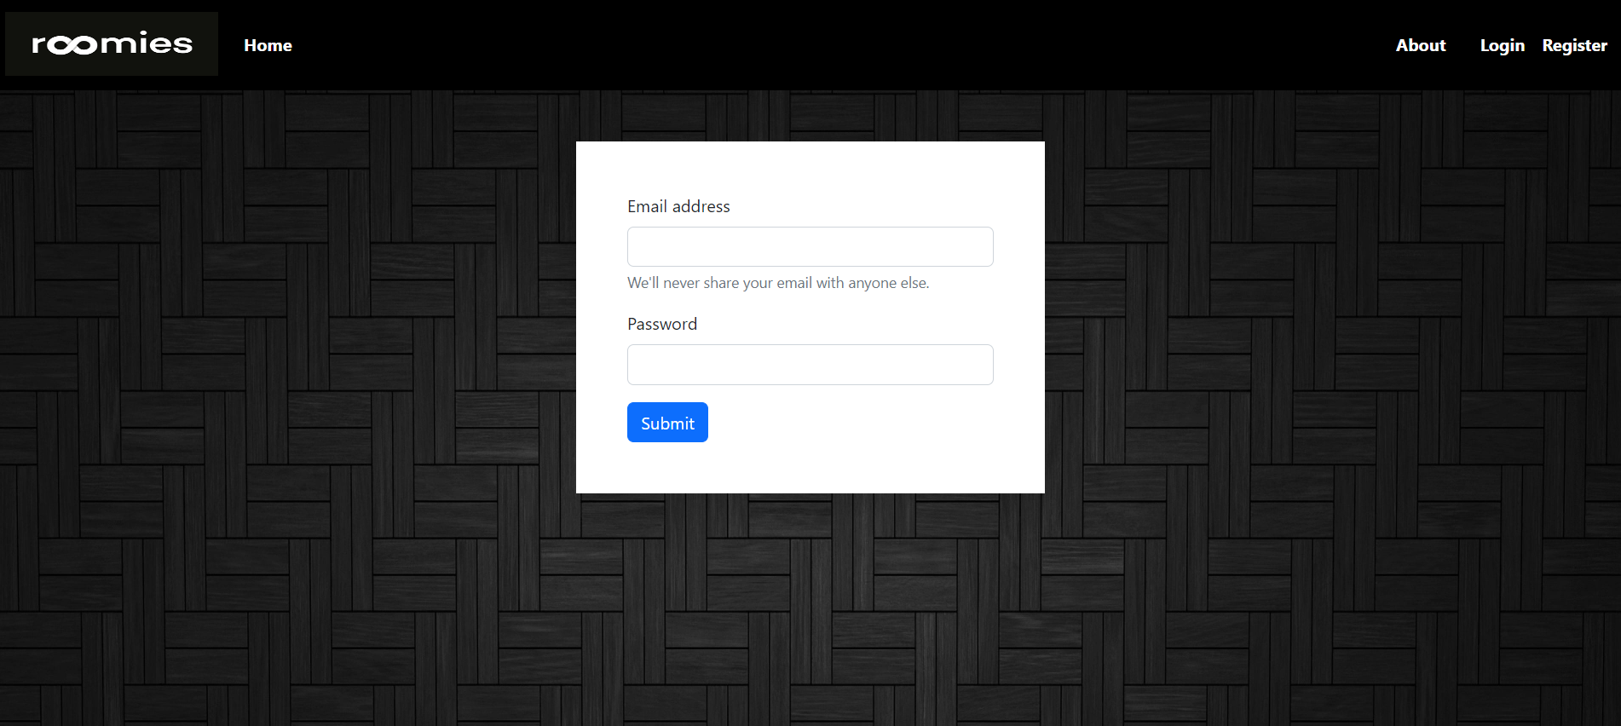
Screenshots

Slide 10
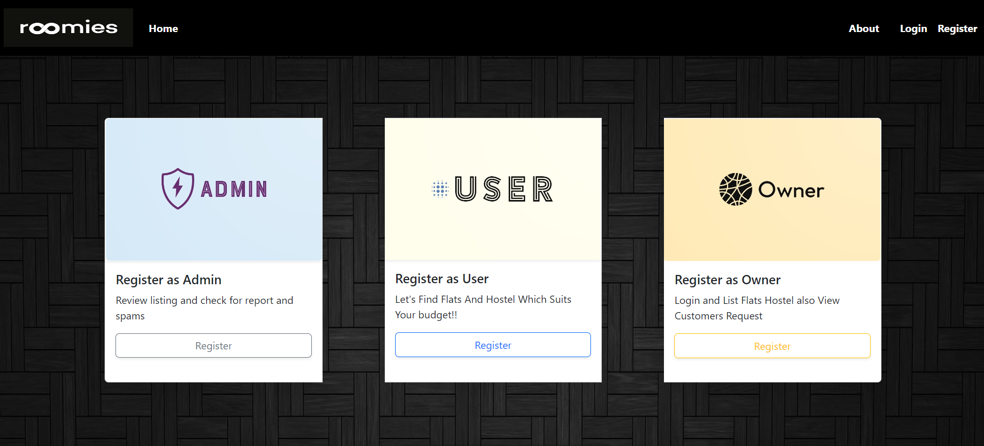
Screenshots

Slide 11
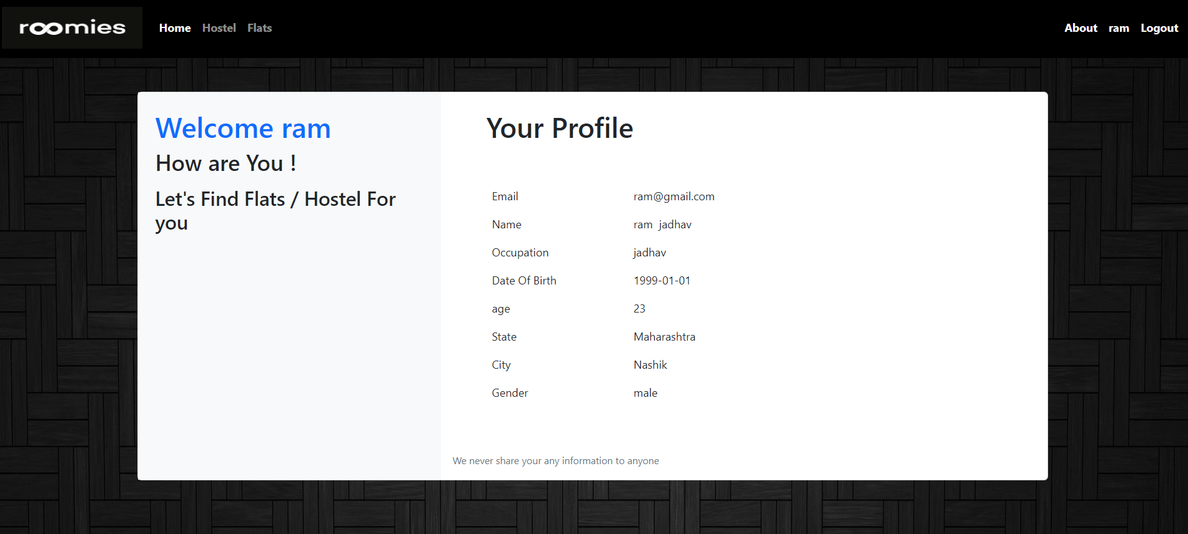
Screenshots

Slide 12
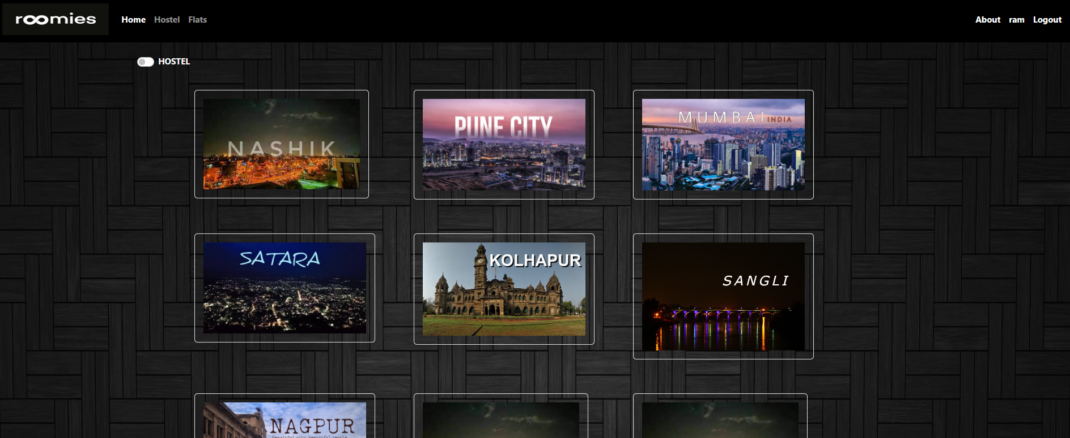
Screenshots

Slide 13
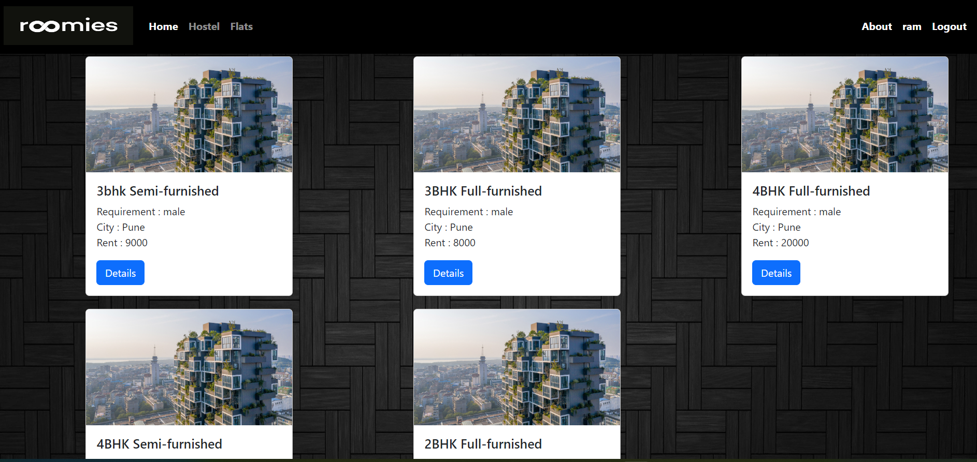
Screenshots

Slide 14
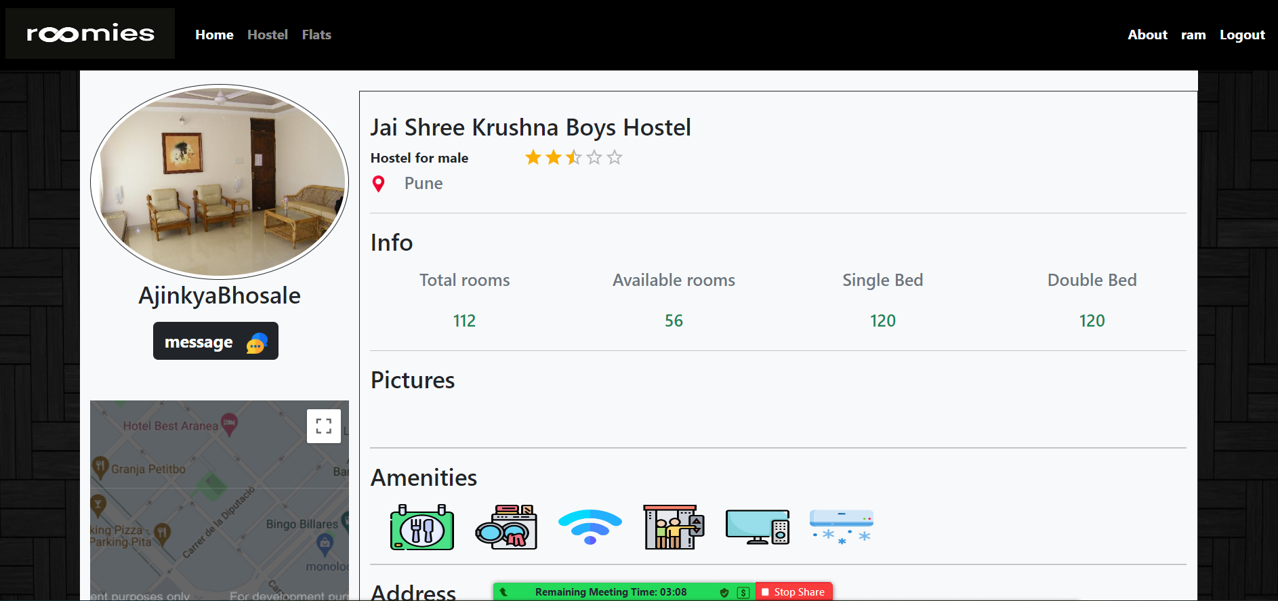
Screenshots

Slide 15
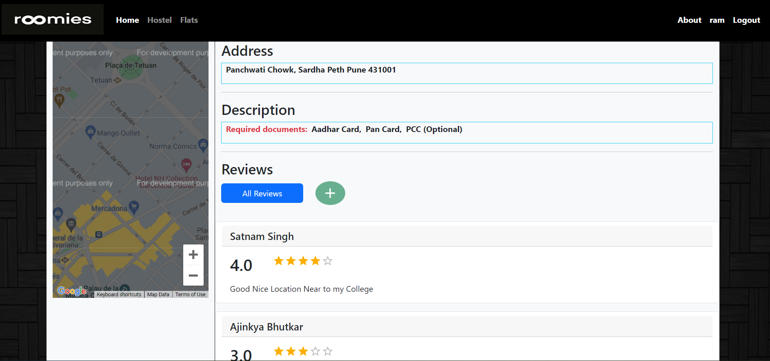
Screenshots

Slide 16
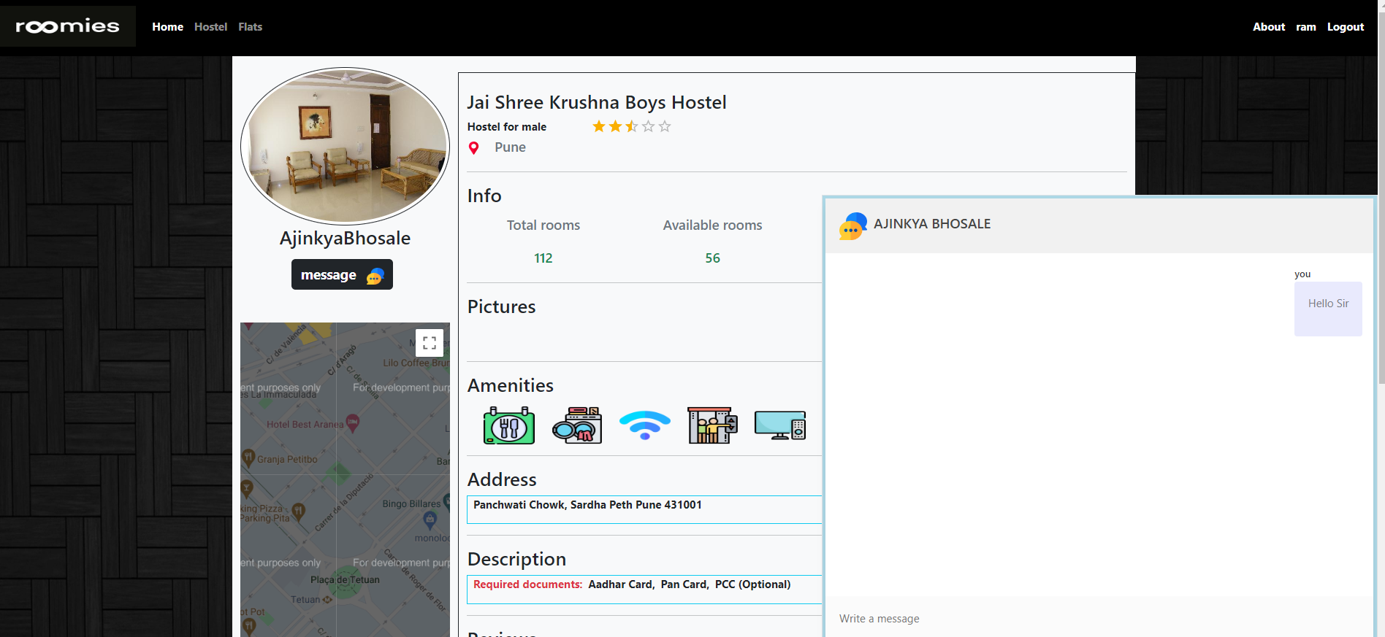
Screenshots

Slide 17
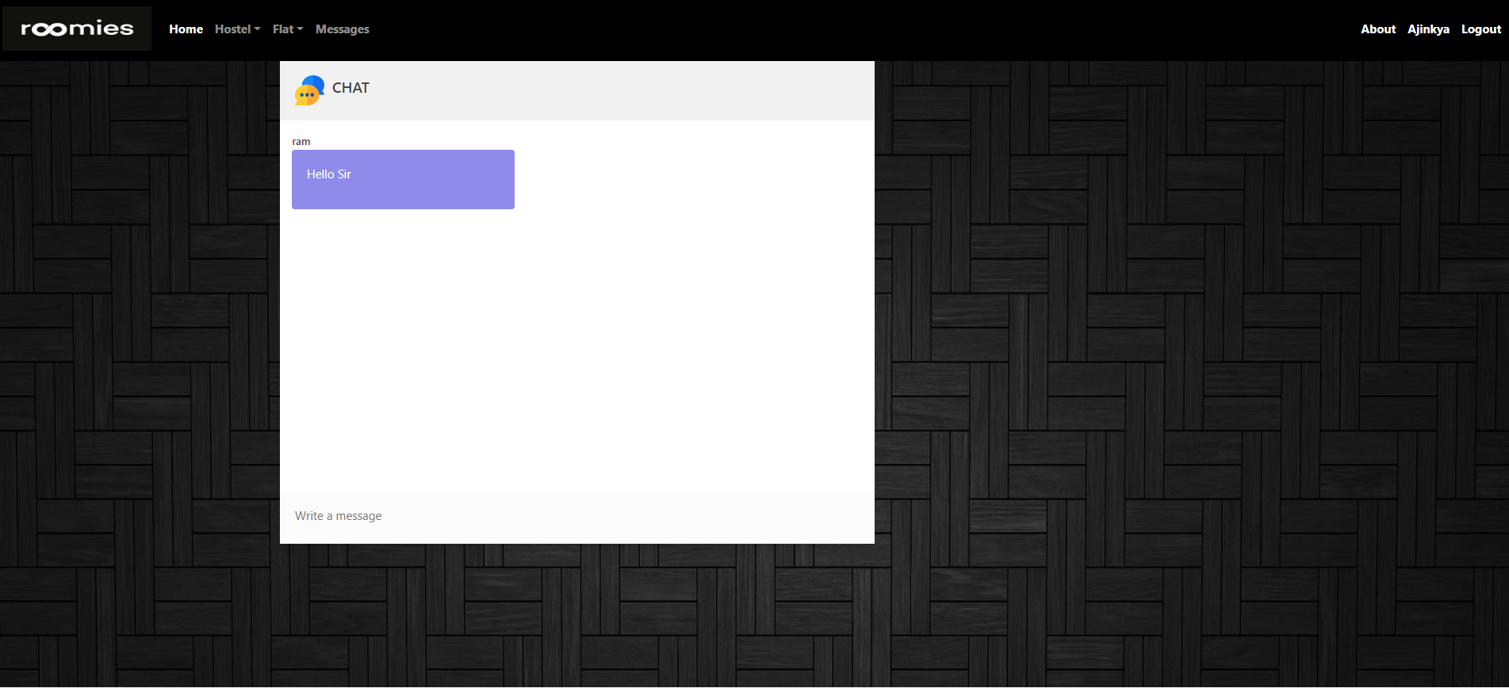
Screenshots

Slide 18
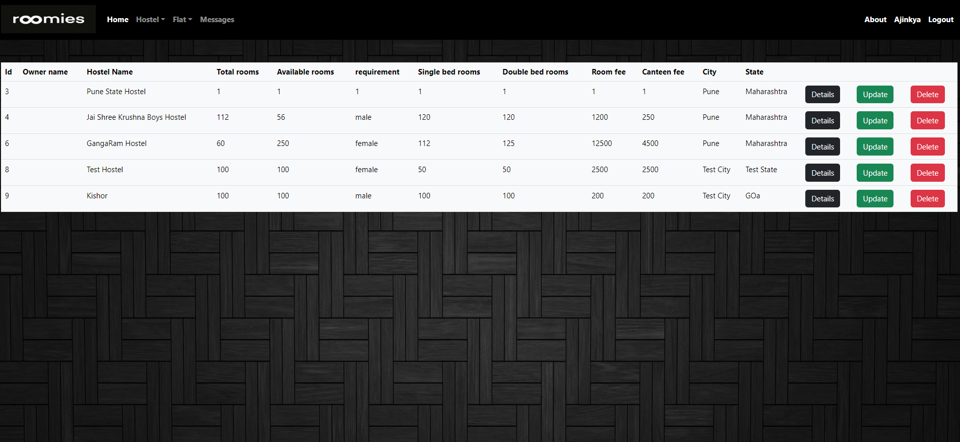
Screenshots

Slide 19
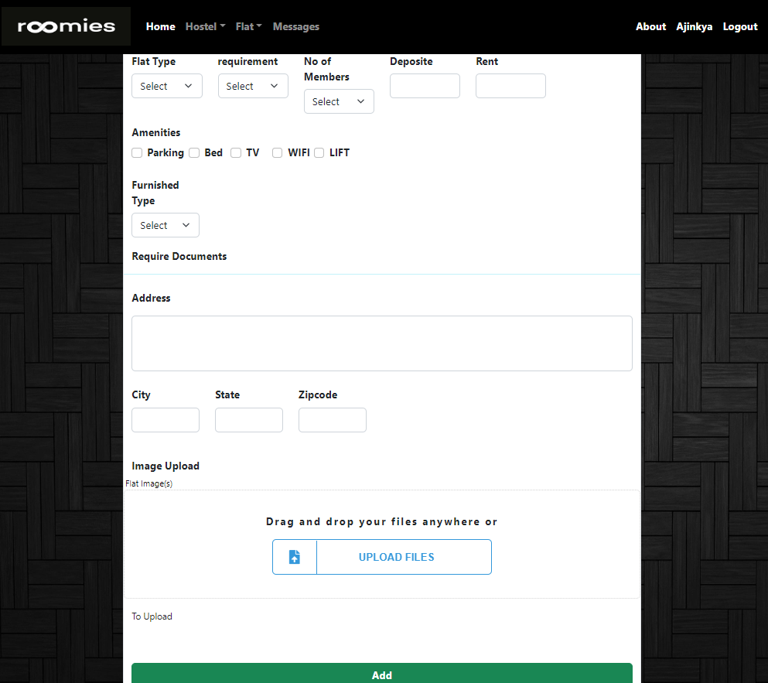
Screenshots

Slide 20
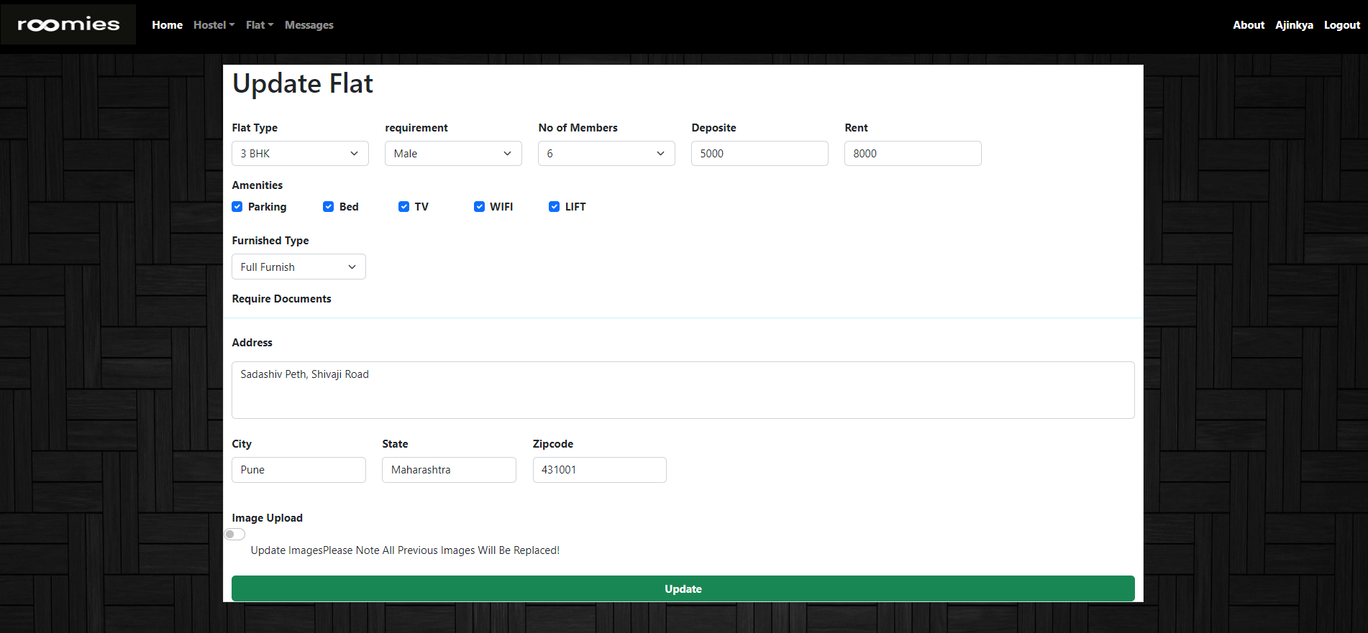
Screenshots

Slide 21
System Requirement
Software Requirement :
Windows 10
Node.js
Express
React.js
MySQL
Hardware Requirement :
RAM 2Gb
Processor Intel Core I3
Hard Disk 5Gb

Slide 22
Technologies Used
HTML : Page Layout has been designed in HTML
CSS : Used For All Designing Part
React : Used For Frontend development (UI)
MySQL : Used for Data Storage
Bootstrap: Used for Responsive Component
Express : Used For Backend Rest API Server
Nodejs : Used For Backend

Slide 23
Applications
For Finding Flats / Hostels Online.
For Listing Flats / Hostels for Renting Purpose.
For Sharing of Flats and Rooms.

Slide 24
Advantages
For Finding Flats / Hostels customer’s doesn’t need to explore market himself.
No Broker Involved so monetary saving of commission.
Owner will get more Customers in less time and will be able to secure best deals.

Slide 25
Limitation
Listing with fake images / details.
Unverified users.
Different life habits of customer and owner.

Slide 26



Conclusion
This WebApp has been Designed and Developed to Overcome the drawbacks and limitations of old Manual processes and meet the requirement of the modern age.
This system will help customers and owners to get the best deal possible out in the market.
This will save Customers as well as Owners time and efforts and will profit both.
Lastly it can be improved in future according to rising demand of users.

Slide 27
Future Scope
Verify
Strict and Legit Verification of Users to avoid Frauds.
Design
Improvement in design.
App
Mobile Application(android and MacOS).
Real Estate
Tie Up
Including Real Estate Module.
Tie-up with Packers & Movers.

Slide 28
References
https://reactjs.org
https://nodejs.org/en
https://expressjs.com
https://getbootstrap.com
https://www.mysql.com

Slide 29


THANK YOU

Slide 30
Proposed Approch

Slide 31
Team
Vadapav Title
Name Title
Name Title
Name Title

Slide 32
Content
Subtitle
Subtitle
Add text, images, art, and videos.
Add transitions, animations, and motion.
Save to OneDrive, to get to your presentations from your computer, tablet, or phone.
Add text, images, art, and videos.
Add transitions, animations, and motion.
Save to OneDrive, to get to your presentations from your computer, tablet, or phone.

Slide 33
Content 2
Subtitle
Subtitle
Subtitle
Add text, images, art, and videos.
Add transitions, animations, and motion.
Save to OneDrive, to get to your presentations from your computer, tablet, or phone.
Add text, images, art, and videos.
Add transitions, animations, and motion.
Save to OneDrive, to get to your presentations from your computer, tablet, or phone.
Add text, images, art, and videos.
Add transitions, animations, and motion.
Save to OneDrive, to get to your presentations from your computer, tablet, or phone.

Slide 34
Conclusion
This WebApp has been Designed and Developed to Overcome the drawbacks and limitations of old Manual processes and meet the requirement of the modern age.
This system will help customers and owners to get the best deal possible out in the market.
This will save Customers as well as Owners time and efforts and will profit both.
Lastly it can be improved in future according to rising demand of users.

Slide 35
Future Scope
Strict Verification of Users to avoid Frauds.
Improvement in design.
Mobile Application.
Including Real Estate Module.
Tie-up with Packers & Movers.

